Slide 1

Grind & Crumb
CEO DASHBOARD AND £1.5M INVESTMENT RECOMMENDATION

Slide 2
The CEO, Anna Whitfield’s Question
"Sales are up, but profit doesn't feel like it. My managers each tell me a different story. Do we open more stores, fix the ones we have, push harder on delivery, or invest in the app? I need to see what's actually going on, store by store, and I need a tool my ops team can keep using after you leave".

Slide 3
The Answer: Fixing The Existing Stores
Sales are up, but only 12p of every £1 reaches store profit. Three leaks explain it: Manchester lunches, Piccadilly’s rent and Leeds cannibalisation.
£8.66M
Sales, Jul 2025 – Jun 2026
£1.07M
Store profit (12.3% margin)

Slide 4
The Problem
The CEO is unable to easily see store profitability.
Manchester Piccadilly
York Stonegate
-£47.8k
+£193.6k
On £1.11m sales, the highest in the chain. Rent and rates take 40.2% of revenue.
On £888.3k sales. It has less sales but is more profitable.
A sales-led view can make a struggling store look like the chain’s strongest performer.

Slide 5
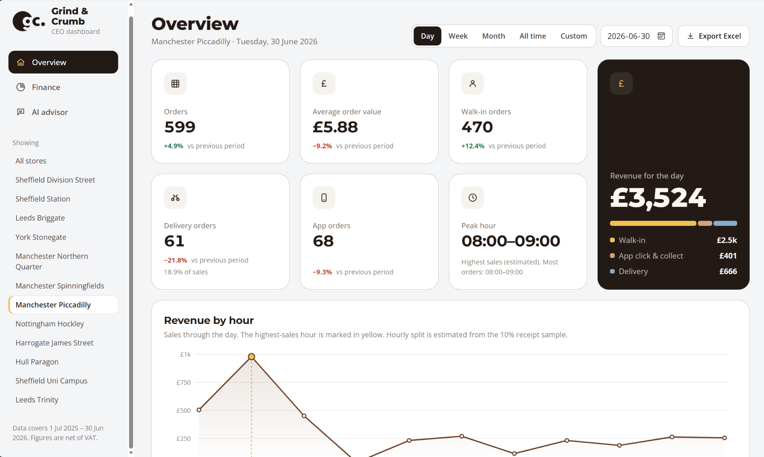
Live Demo: CEO Dashboard Application

Slide 6
OUR RECOMMENDATION
We recommend staged funding of £1.5m, with £610k held for results.
Investment priority | Allocation
Dashboard and reporting | £60,000
App reliability and recovery | £110,000
Staffing and retention | £430,000
Waste and operating improvements | £40,000
Store and property turnaround | £150,000
Oat surcharge Removal Trial | £100,000
Conditional reserve (released on results) | £610,000
Total | £1,500,000
Illustrative payback period: 3.4 years
Assuming an extra £3 profit per £100 of sales, annual profit would increase by approximately £260k.
£890k ÷ £260k ≈ 3.4 years.
Excludes the £610k reserve; assumes immediate, sustained benefits.
What we would stop
Ranking stores by sales, chasing delivery growth without contribution analysis, expanding before comparing returns, blanket labour cuts.
5

Slide 7
Our Request to the Board
We ask the board to approve staged, results-based funding.
Risk | Control
Estimates mislead decisions | Clearly separate actual figures from estimates
Interventions fail to deliver expected benefits | Test on a small scale before expanding
AI may produce unreliable advice | Check recommendations against data and require management review
Decision requested: Adopt the CEO dashboard.
6
Notes:
30 seconds. Choose two or three risks, pair each with a control, then finish decisively on the ask.

